Slide 1
Azure Storage and the Azure CLI
Microsoft Research

Slide 2
Azure Storage
Store data cheaply, reliably, and with high availability
Accessible anywhere and in any programming language
Blobs
Tables
Queues
Files

Slide 3
Blob Storage
Accounts
Containers
Blobs
images
schema.jpg
a4rlabs
Png/flow.png
documents
Labs.pdf
3 to 24 characters
0-9 and a-z
Unique within Azure
3 to 63 characters
0-9, a-z, and dashes
1 to 1,024 characters
Any characters (including slashes)
URL characters must be escaped
Max. 254 path segments

Slide 4
Blob URLs
Accounts
Containers
Blobs
images
schema.jpg
a4rlabs
Png/flow.png
documents
Labs.pdf
http[s]://a4rlabs.blob.core.windows.net/images/schema.jpg

Slide 5
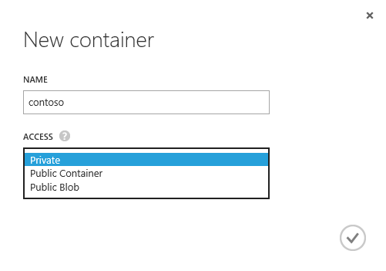
Container Access Policy
Each container is assigned one of three access policies
Private – Blobs can't be read anonymously or enumerated
Public Container – Blobs can be read anonymously, but cannot be enumerated
Public Blob – Blobs can be read anonymously and enumerated

Slide 6
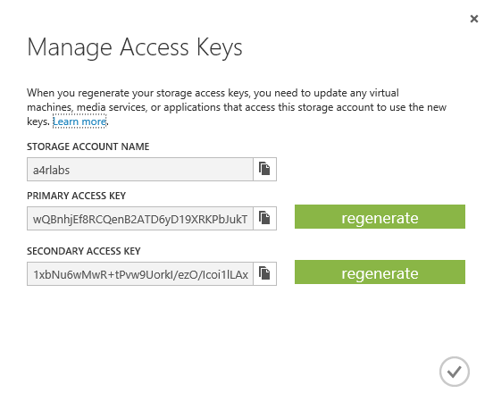
Access Keys
Access to storage by non-account-owners relies on keys for authentication
Two 512-bit keys per account
Keys should be "rolled" periodically for security
Keys can be used to generate shared-access signature (SAS) tokens for secure, time-limited access

Slide 7
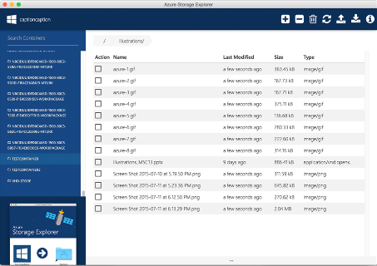
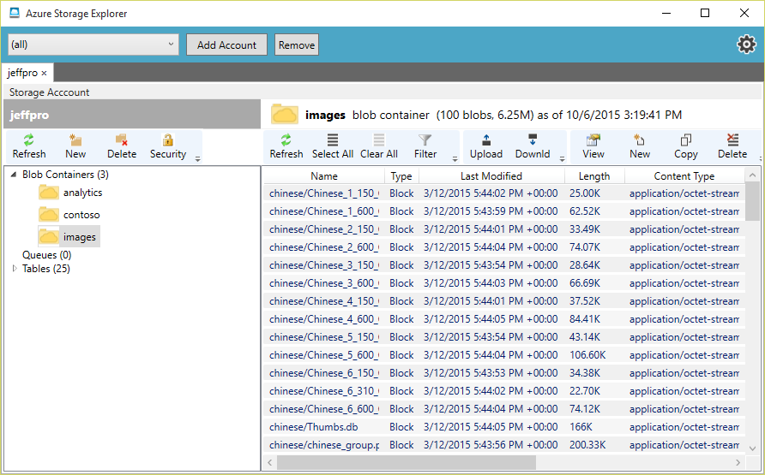
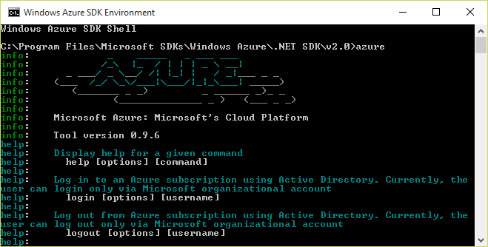
Azure Storage Tools
Portal doesn't provide functionality for uploading blobs
See http://storagetools.azurewebsites.net/ for tools that do
Storage Explorer (x-plat)
Azure Storage Explorer (Windows)
Azure CLI (x-plat)

Slide 8
Uploading a Blob with the Azure CLI
Local file name
Container name
Blob name
azure storage blob upload banner.jpg images banner.jpg
-a a4rlabs -k accesskey

Slide 9
Demo
Working with Storage

Slide 10
Hands-On Lab
Azure Storage and the CLI
StorageHOL.pdf

